Slide 1
CHAPTER FIVE
MOTIVATION AND EMOTIONS

Slide 2
5.1. Motivation 5.1.1. Definition and types of motivation
Motivation is a force/factor that initiate, direct and persist peoples’ behaviour towards purpose.
For example, hunger cause the person to get up, go into the kitchen, and search for something to eat.
The hunger causes the action (getting up), directs it (going to the kitchen), and sustain the search (finding or preparing something to eat).

Slide 3
Types of motivation
It is possible to categorize motivation into two: intrinsic and extrinsic motivation.
Intrinsic motivation is a type of motivation in which a person acts because the act itself is rewarding or satisfying in some internal manner.
Extrinsic motivation is a type of motivation in which individuals act because the action leads to an outcome that is external to a person.
Motives are also frequently divided into:
physiological, primary, or organic motives, such as hunger, thirst, and need for sleep; and
personal, social, or secondary motives, such as affiliation, competition, & individual interests & goals.

Slide 4
5.1.2. Approaches to motivation (theories of motivation)
It explains about the sources of our motivation. Some of these theories are instinct, drive-reduction, arousal, incentive, cognitive, and humanistic.
Instinct approaches to motivation
Focused on the biologically determined and innate patterns of both humans and animals behavior. It realize that some human behavior is controlled by hereditary factors.
For example, animals are governed by their instincts to do things such as reproducing, migrating, nest building, mating and protecting their territory, early researchers proposed that human beings may also be governed by similar instincts.
The early theorists and psychologists listed thousands of instincts in humans including curiosity, flight (running away), pugnacity (aggressiveness), and acquisition (gathering possessions).

Slide 5
b) Drive-reduction approaches to motivation
A need is a requirement of some material (such as food or water) that is essential for the survival of the organism.
When an organism has a need, it leads to a psychological tension as well as physical arousal to fulfill the need and reduce the tension. This tension is called drive.
Drive-reduction theory proposes just this connection between internal psychological states and outward behavior. In this theory, there are two kinds of drives.
Primary drives are those that involve survival needs of the body such as hunger and thirst
Secondary (acquired) drives are those that are learned through experience or conditioning, such as the need for money, social approval.
This theory also includes the concept of homeostasis, or the tendency of the body to maintain a steady-state.

Slide 6
c) Arousal approaches: beyond drive reduction
Arousal approaches seek to explain behavior in which the goal is to maintain or increase excitement.
According to arousal approaches, each person tries to maintain a certain level of stimulation and activity.
As with the drive-reduction model, this approach suggests that if our stimulation and activity levels become too high, we try to reduce them.
But, in contrast to the drive-reduction perspective, the arousal approach also suggests that if levels of stimulation and activity are too low, we will try to increase them by seeking stimulation.

Slide 7
d) Incentive approaches: motivation’s pull
Incentive approaches suggest that motivation stems from the desire to attain external rewards, known as incentives.
In this view, external stimuli such as grades, money, affection, food, or sex - account for a person‘s motivation.
Many psychologists believe that the internal drives “push” proposed by drive-reduction theory work in a cycle with the external incentives of incentive “pull” theory.
Hence, at the same time that we seek to satisfy our underlying hunger needs (the push of drive-reduction theory), we are drawn to food (the pull of incentive theory).
Rather than contradicting each other, then, drives and incentives may work together in motivating behavior.

Slide 8
e) Cognitive Approaches: the thoughts behind motivation
Cognitive approaches to motivation suggest that motivation is a result of people’s thoughts, beliefs, expectations, and goals.
For instance, the degree to which people are motivated to study for a test is based on their expectation of how well studying will pay off in terms of a good grade.
Cognitive theories of motivation draw a key difference between intrinsic and extrinsic motivation.
Intrinsic motivation causes us to participate in an activity for our enjoyment rather than for any actual or concrete reward that it will bring us.
In contrast, extrinsic motivation causes us to do something for money, a grade, or some other actual, concrete reward.
Compare students studying for grade and for knowledge
Notes:
For example, when a teacher provides tutorial support for students in her extra time because she loves teaching, intrinsic motivation is prompting her; if she provides tutorial support to make a lot of money, extrinsic motivation underlies her efforts. Similarly, if you study a lot because you love the subject matter, you are being guided by intrinsic motivation. On the other hand, if all you care about is the grade to get in the course, it is extrinsic motivation.

Slide 9
f) Humanistic approaches to motivation
Maslow rejected the dominant theories of psychoanalysis and behaviorism in favor humanistic view.
Maslow suggested that human behavior is influenced by a hierarchy, or ranking, of five classes of needs, or motives. He said that needs at the lowest level of the hierarchy must be satisfied before people can be motivated by the higher levels.
Maslow’s five Hierarchies of needs for motives from the bottom to the top are as follows:
Physiological needs - are biological requirements for human survival, e.g. air, food, drink, shelter, warmth, sex, sleep.
Safety needs - protection from elements, security, order, law, stability, freedom from fear.

Slide 10
…
3. Love and belongingness needs - the third level of human needs is social and involves feelings of belongingness. Examples include friendship, intimacy, trust, and acceptance in a group, receiving and giving affection and love.
4. Esteem needs - the need to be respected as a useful, honorable individual; which Maslow classified into two categories: (i) esteem for oneself (dignity, achievement, mastery, independence) and (ii) the desire for reputation or respect from others (e.g., status, prestige).
5. Self-actualization needs - realizing personal potential, self-fulfillment, seeking personal growth and peak experiences. A desire ―to become everything one is capable of becoming‖.
The following figure shows how our motivation progresses up the pyramid from broadest(most fundamental) to higher-order ones.

Slide 11
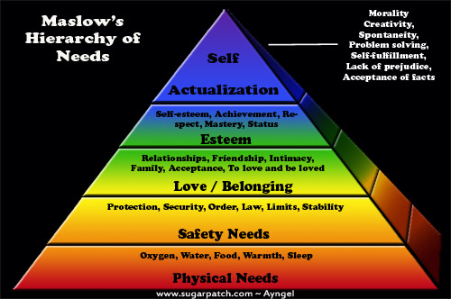
Maslow’s Hierarchy of Needs

Slide 12
5.1.3. Conflict of motives and frustration
Based on the sources of motivation and the importance of the decision, we usually face difficulty in choosing among motives.
When the decision is more important, the number and strength of motivational pushes and pulls are often greater, creating far more internal conflict and indecision.
There are four basic types of motivational conflicts. Approach-approach conflicts - exist when we must choose only one of the two desirable activities. Example, going to a movie or a concert. Avoidance-avoidance conflicts - arise when we must select one of two undesirable alternatives. Someone forced either to sell the family home or to declare bankruptcy.

Slide 13
…
Approach-avoidance conflicts - happen when a particular event or activity has both attractive and unattractive features, e.g., a freshman student wants to start dating but she, at the same time, is worried that this may consume her study time.
Multiple approach-avoidance conflicts - exist when two or more alternatives each have both positive & negative features.
E.g., you must choose between two jobs. One offers a high salary with a well-known company but requires long working hours and relocation to a miserable climate. The other boasts advancement opportunities, fringe benefits, and a better climate, but it doesn‘t pay as much and involves an unpredictable work schedule.

Slide 14
5.2. Emotions 5.2.1. Definition of emotion
Emotion is a negative or positive feeling generally in reaction to stimuli that are accompanied by physiological arousal and related behavior
Emotion is a complex reaction pattern, involving experiential, behavioral, and physiological elements, by which an individual attempts to deal with a personally significant matter or event.
It is the feeling aspect of our consciousness.

Slide 15
Emotion
Components of emotion
Physical component – physiological arousal (internal body state accompanying the emotion)
Cognitive component – the way we interpret a stimulus or a situation
Behavioral component – outward expression of the emotion (facial expressions gesture, body posture, tone of voice)

Slide 16
.
The physiology of emotion - when a person experiences an emotion, there is physical arousal created by the sympathetic nervous system. The heart rate increases, breathing becomes more rapid, the pupils of the eye dilate, and the moth may become dry.
Although facial expressions do differ between various emotional responses, emotions are difficult to distinguish from one another based on outward bodily reactions alone.

Slide 17
The behavior of emotion - tells us how people behave in the grip of an emotion. There are facial expressions, body movements, and actions that indicate to others how a person feels.
Frowns, smiles, and sad expressions combine with hand gestures, the turning of one‘s body, and spoken words to produce an understanding of emotion.
People fight, run, kiss, and yell, along with countless other actions stemming from the emotions they feel. Facial expressions can vary across different cultures, although some aspects of facial expression seem to be universal.

Slide 18
Subjective experience or labeling emotion is the third component of emotion and it involves interpreting the subjective feeling by giving it a label: anger, fear, disgust, happiness, sadness, shame, interest, surprise and so on.
This component is also called “cognitive component” because the labeling process is a matter of retrieving memories of previous similar experiences, perceiving the context of the emotion, and coming up with a solution- a label.
The label a person applies to a subjective feeling is at least in part a learned response influenced by that person‘s language and culture. Such labels may differ in people of different cultural backgrounds.

Slide 19
Basic Emotions
The revised model of basic emotions includes:
Happiness
Surprise
Sadness
Fear
Disgust
Anger

Slide 20
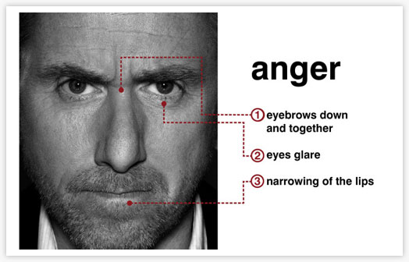
Anger

Slide 21
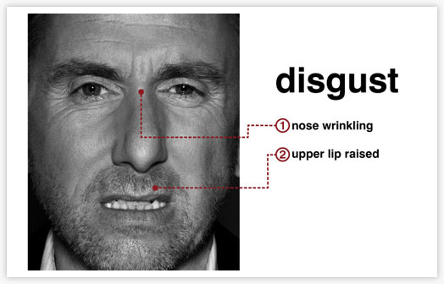
Disgust

Slide 22
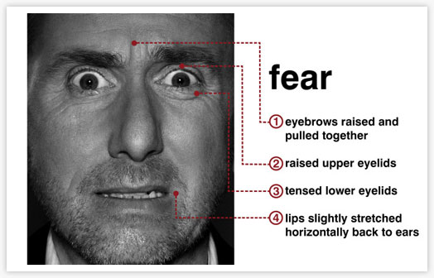
Fear

Slide 23
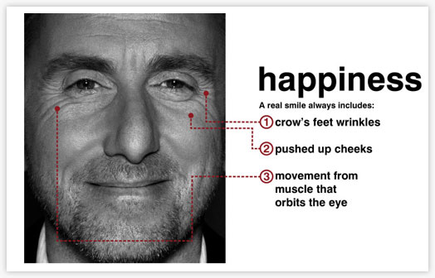
Happiness

Slide 24
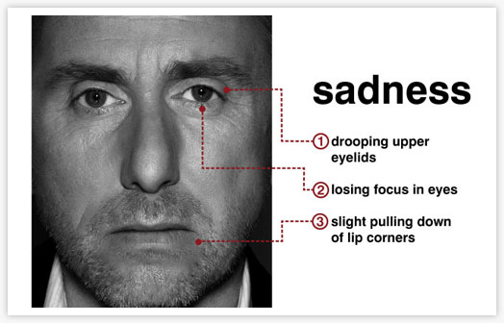
Sadness

Slide 25
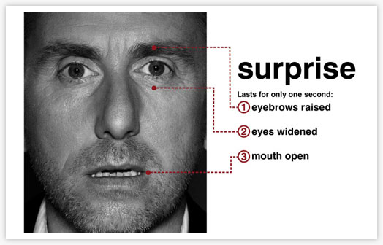
Surprise

Slide 26
Theories of emotion
James-Lang Theory of Emotion
In this theory, a stimulus of some sort (for example, the large snarling dog) produces a physiological reaction. This reaction, which is the arousal of the “fight-or-flight” sympathetic nervous system (wanting to run), produces bodily sensations such as increased heart rate, dry mouth, and rapid breathing.
James and Lang believed that physical arousal led to the labeling of the emotion (fear).
Simply put, “I am afraid because I am aroused,”
“I am embarrassed because my face is red,” and
“I am in love because of my heart rate increases when I look at her or him.”

Slide 27
.
II. Cannon-Bard theory of emotion
Physiologists Cannon and (1927) and Bard (1934) theorized that the emotion and the physiological arousal occur more or less at the same time.
For example, the fear and the bodily reactions are, therefore, experienced at the same time-not one after the other.
“I am afraid and running and aroused!”

Slide 28
.
III. Schechter-Singer and Cognitive Arousal Theory The early theories talked about the emotion and the physical reaction, but what about the mental interpretation of those components?
In their cognitive arousal theory, Schachter-Singer (1962) proposed that two things have to happen before emotion occurs: the physical arousal and labeling of the arousal.
These two things happen at the same time, resulting in the labeling of the emotion.
For example, if a person comes across a snarling dog while taking a walk, the physical arousal (heart racing, eyes opening wide) is accompanied by the thought (cognition) that this must be fear. Then and only then will the person experience the fear of emotion.
In other words, “I am aroused in the presence of a scary dog; therefore, I must be afraid.”

Slide 29
James-Lange theory
Physiological arousal trembling increased heart rate
Stimulus snake
Emotion fear
Physiological arousal trembling increased heart rate
Cannon-bard theory
Stimulus snake
Sub-cortical brain -activity
Emotion fear
Physiological arousal trembling increased heart rate
Schechter- singer theory
Stimulus
Emotion fear
Cognitive interpretation “I feel afraid!”

